Slide 1

Private Health Insurance Analysis
Ray, Ina, Laszlo
16 May 2023

Slide 2
Project Aim:
Our goal is to employ Machine Learning to forecast Health Insurance prices for a business named “Happy Life Health Cover” in the US by analyzing a dataset that contains information on several factors that impact medical expenses and insurance premiums in the country.

Slide 3
Technologies Used:
Python modules and libraries
flask
flask-sqlalchemy
sqlalchemy
pandas
scikit-learn
joblib
json
numpy
Sklearn
SQLite
HTML / Css / JavaScript / Bootstrap
D3.plotly
Chart.js

Slide 4
What is Health Insurance?
Health insurance is a type of coverage that helps individuals pay for medical expenses and services.
Premiums are the regular payments individuals or employers make to maintain health insurance coverage.
Health insurance plans differ in coverage levels, benefits, limits, and exclusions.
Relevance of Machine Learning in predicting Health Insurance costs
Able to analyze large amounts of data and identify patterns, correlations, and trends to estimate or forecast future costs.
By using historical data and relevant variables, Machine Learning algorithms can learn from patterns and make predictions about future costs.
Machine Learning models can adapt and improve over time as they receive more data and feedback, leading to more accurate cost predictions.

Slide 5
Data Collection, Pre-processing:
The data from Kaggle contained 1,000,000 lines of entries.
The data was checked for empty and duplicate entries.
Attributes with categorical data were checked for unique values. Each attribute contained acceptable number of categories for our analysis.

Slide 6
Machine Learning Algorithms Used:
The following models were used:
Linear Regression
Decision Tree Regressor
Data preparation
Data was separated as noted below and OneHotEncoder was used on categorical data.
Features | Target
Numerical Data: | Charges
Age
bmi
children
Categorical data
gender
smoker
region
medical_history
family_medical_history
exercise_frequency
occupation
coverage_level

Slide 7
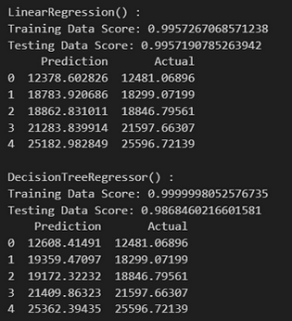
Findings:

Slide 8
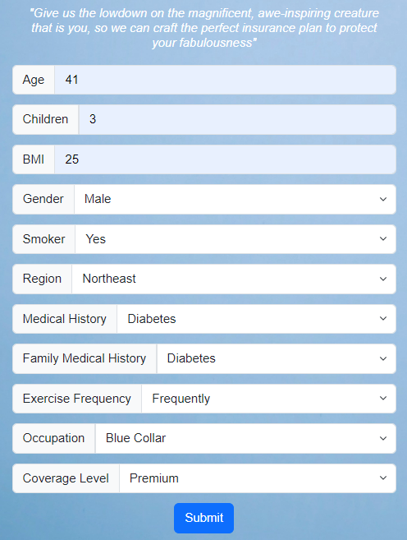
Prediction:
Model used: model_DecisionTreeRegressor.joblib
Data Input for Prediction
HTML form using flask
Data submitted saved in SQLite

Slide 9
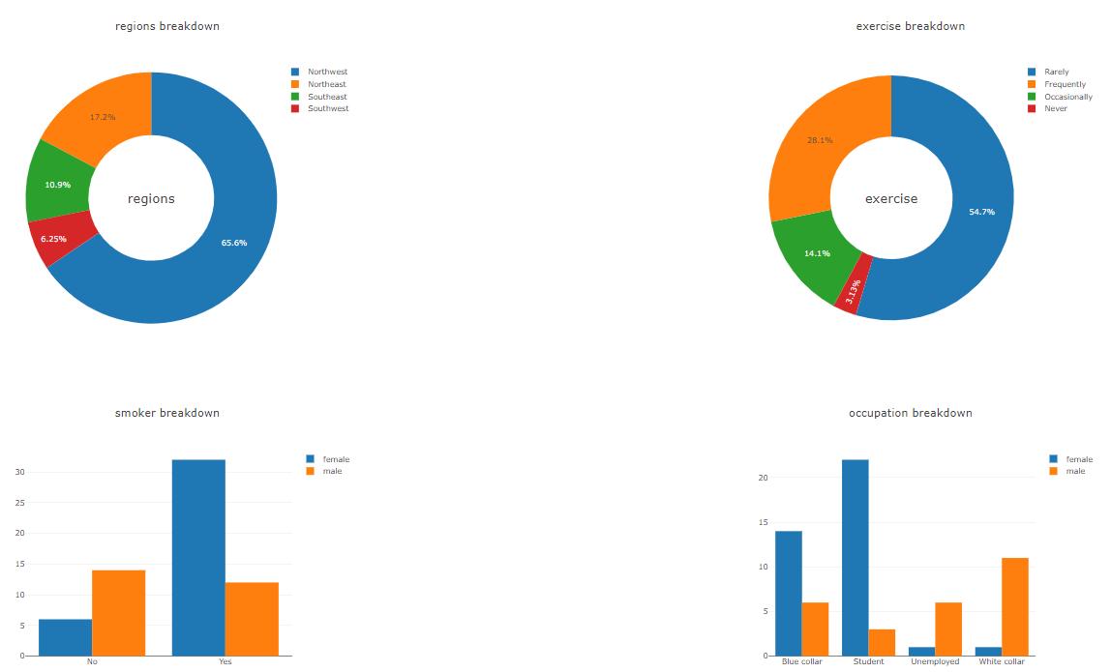
Analysis of Submitted Data:
SQLite data was used for business opportunity analysis

Slide 10
Limitations & Challenges:
Large dataset
Dataset appeared to be fabricated to create uniform dataset for all categories.
Issue for data analysis, not for machine learning

Slide 11
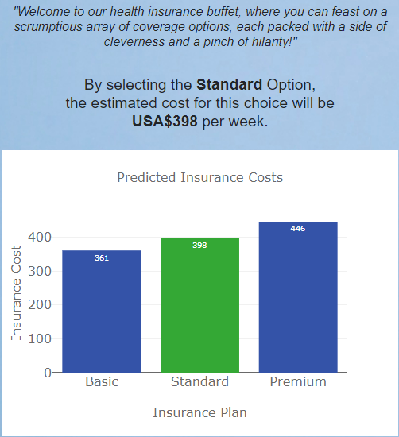
Conclusion:
A Machine Learning model provides fast and accurate prediction for a given situation.
In our case it provided the insurance premium not only for the plan option chosen by the customer, but also for alternative options as well.

